Slide 1
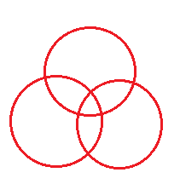
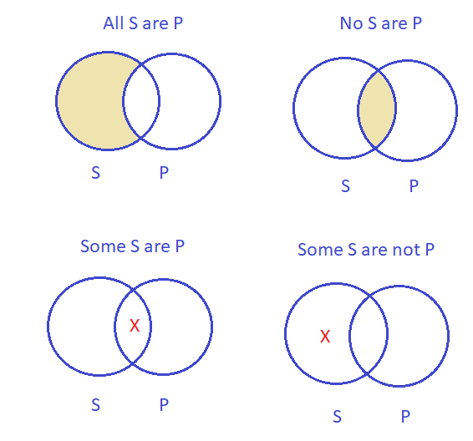
Review: Categorical Logic
Four categorical propositions
Venn diagram
Rules for validity check
- Draw 2 circles at bottom, one on top
- Label 2 classes in conclusion at bottom
- Perform only two actions for 2 premises
- Check validity:
+ Action for conclusion already done: Valid
Stylistic variants
+ Action for conclusion not yet done: Invalid
All S are P:
words of extremes, positive forms
No S are P:
words of extremes, negative forms
Some S are P:
more than one → nearly all, positive forms
Some S are not P:
more than one → nearly all, negative forms

Slide 2
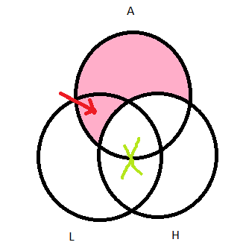
Question 4
Create a categorical syllogism: 1) with both premises in the standard forms and the conclusion in the stylistic form, and 2) about the topic of how you think about weekly assignments. Then check its validity using Venn diagram.
Quantifiers?
Stylistic argument:
Weekly assignments are hard to do, not only hard but also so long. Therefore weekly assignments always take lot of time to thinking
Standardized argument:
_All weekly assignments (A) are hard (H).
_Some are long(L).
_So all weekly assignments are long(L).
Invalid
Symbolic argument:
_All A are H.
_Some A are L
_So all A are L
Notes:
Nguyễn Ngọc Minh Tú – FAFBIU22262 2. Trần Nguyễn Minh Thư – FAFBIU22258 3. Nguyễn Thảo Như – FAFBIU22256 4. Phạm Vũ Uyên Nhi – FAFBIU22255 5. Lưu Nguyễn Ngọc Nhi – FAFBIU22134 6. Nguyễn Trương Trúc Linh - FAFBIU22085 7. Dương Trung Tín - MAMAIU22155

Slide 3
Question 4 - modified
Create a categorical syllogism: 1) with both premises in the standard forms and the conclusion in the stylistic form, and 2) about the topic of how you think about weekly assignments. Then check its validity using Venn diagram.
Stylistic argument:
All weekly assignments are hard to do.
Most hard exercises are also so long.
So weekly assignments always take lot of time to think.
Standardized argument:
All weekly assignments (A) are hard exercises (H).
Some hard exercises are long time takers (L).
So all weekly assignments are long time takers (L).
Symbolic argument:
All A are H
Some H are L
So all A are L
Notes:
Nguyễn Ngọc Minh Tú – FAFBIU22262 2. Trần Nguyễn Minh Thư – FAFBIU22258 3. Nguyễn Thảo Như – FAFBIU22256 4. Phạm Vũ Uyên Nhi – FAFBIU22255 5. Lưu Nguyễn Ngọc Nhi – FAFBIU22134 6. Nguyễn Trương Trúc Linh - FAFBIU22085 7. Dương Trung Tín - MAMAIU22155

Slide 4
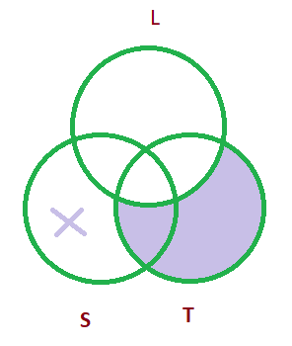
Question 5
Create a categorical syllogism 1) with the premises containing No & Some and the conclusion containing All, 2) all three statements must be the stylistic variants, and 3) about the topic of gains/losses of going on with Semester 2 in the summer time. Then standardize it and check its validity using Venn diagram.
Stylistic argument: 1) some students are not learning in summertime
2) only if they learn in summertime they can have more free time
3) at least one student don’t have more free time than other
Standardized argument: Some students(s) are not learning in summertime(L)
all freetime students (T) are summertime learner
so, some students are not free in summertime
Symbolic argument:
Some S are not L
All T are L
So , some S are not T
Conclusion: this is a valid argument. There is at least one X in the area of S outside T
Notes:
Nguyễn Huy Bình Dương + ITITIU22222
Lữ Triều Hưng + ITITDK22020
Đỗ Hoàng Minh + ITITWE22142
Trần Tăng Lộc + ITITDK22031
Chu Trường Giang + ITITUN22048
Phùng Huy Quang + ITITWE22145
Nguyễn Công Tuấn Vũ + ITITUN22053
Nguyễn Anh Minh + ITITWE22033

Slide 5
Question 5 – modified
Create a categorical syllogism 1) with the premises containing No & Some and the conclusion containing All, 2) all three statements must be the stylistic variants, and 3) about the topic of gains/losses of going on with Semester 2 in the summertime. Then standardize it and check its validity using Venn diagram.
Stylistic argument: Some students are not learning in the summertime.
Only if they learn in summertime they can have more free time.
At least one student don’t have more free time than other.
Standardized argument: Some students(S) are not summertime learners. (L)
All free-time students (T) are summertime learners.
So, some students are not free-time students.
Symbolic argument:
Some S are not L
All T are L
So , some S are not T
Conclusion: This is a valid argument. There is at least one X in the area of S outside T
Notes:
Nguyễn Huy Bình Dương + ITITIU22222
Lữ Triều Hưng + ITITDK22020
Đỗ Hoàng Minh + ITITWE22142
Trần Tăng Lộc + ITITDK22031
Chu Trường Giang + ITITUN22048
Phùng Huy Quang + ITITWE22145
Nguyễn Công Tuấn Vũ + ITITUN22053
Nguyễn Anh Minh + ITITWE22033

Slide 6
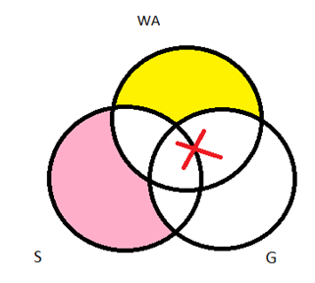

Question 4
Create a categorical syllogism: 1) with both premises in the standard forms and the conclusion in the stylistic form, and 2) about the topic of how you think about weekly assignments. Then check its validity using Venn diagram.
No weekly assignments are easy exercises for students to do.
All students in class have to create their own group for Critical Thinking
So, most students have to do weekly assignments with their group.
Standardized argument:
Weekly assignments (WA) are difficult for students(S) to complete
All students (S) have to find a group (G) to do weekly assignments.
So, some weekly assignments (WA) will have been done by groups(G)in class
Symbolic argument:
WA are S
All S are G
So, some WA are G
Conclusion: VALID
Notes:
Bùi Ngọc Anh-IELSIU22332
Trần Minh Hạnh-IELSIU22324
Dương Kiều Ngân-IELSIU22333
Phan Đại Nghĩa-IELSIU22286
Đỗ Nhật Bảo Trân-IELSIU22319
Phạm Ngọc Vĩnh-IELSIU22273
Nguyễn Văn Vĩnh-EEACIU22174
Nguyễn Minh Quân-ITITIU22130

Slide 7
Question 4 - modified
Create a categorical syllogism: 1) with both premises in the standard forms and the conclusion in the stylistic form, and 2) about the topic of how you think about weekly assignments. Then check its validity using Venn diagram.
No weekly assignments are easy exercises for students.
All students (S) who have to work in groups do weekly assignments.
So, most students have to do work in groups do easy exercises.
Standardized argument:
No weekly assignments (WA) are easy exercises (E).
All groups’ tasks (T) are weekly assignments.
So, some group tasks (T) are easy exercises(E).
Symbolic argument:
No WA are E
All T are WA
So, some T are E
Notes:
Bùi Ngọc Anh-IELSIU22332
Trần Minh Hạnh-IELSIU22324
Dương Kiều Ngân-IELSIU22333
Phan Đại Nghĩa-IELSIU22286
Đỗ Nhật Bảo Trân-IELSIU22319
Phạm Ngọc Vĩnh-IELSIU22273
Nguyễn Văn Vĩnh-EEACIU22174
Nguyễn Minh Quân-ITITIU22130

Slide 8
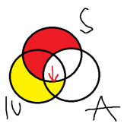
Question 4 - correct
Create a categorical syllogism: 1) with both premises in the standard forms and the conclusion in the stylistic form, and 2) about the topic of how you think about weekly assignments. Then check its validity using Venn diagram.
Stylistic argument:
All students do the weekly assignments.
All IU-ers are students.
All IU-ers do weekly assignments.
Venn diagram
Standardized argument:
All students (S) are doers of weekly assignments (A).
All IU-ers (IU) are students (S).
All IU-ers (IU) are doers of weekly assignments (A).
Symbolic argument:
All S are A.
All IU are S.
All IU are A.
Conclusion: Valid
Notes:
1. Nguyễn Phước Trọng Nhân - EEEEIU22076
2. Đinh Gia Đạt - EEEEIU22060
3. Trần Đăng Khoa - EEEEIU22071
4. Vương Thanh Tùng - EEEEIU22079
5. Lạc Dương Tân - EEEEIU22045
6. Nguyễn Trung Tín - EEEEIU2088
7. Trần Ngọc Khôi Nguyên - EEEEIU22077
8. Nguyễn Thành Nhân - EEEEIU22073

Slide 9
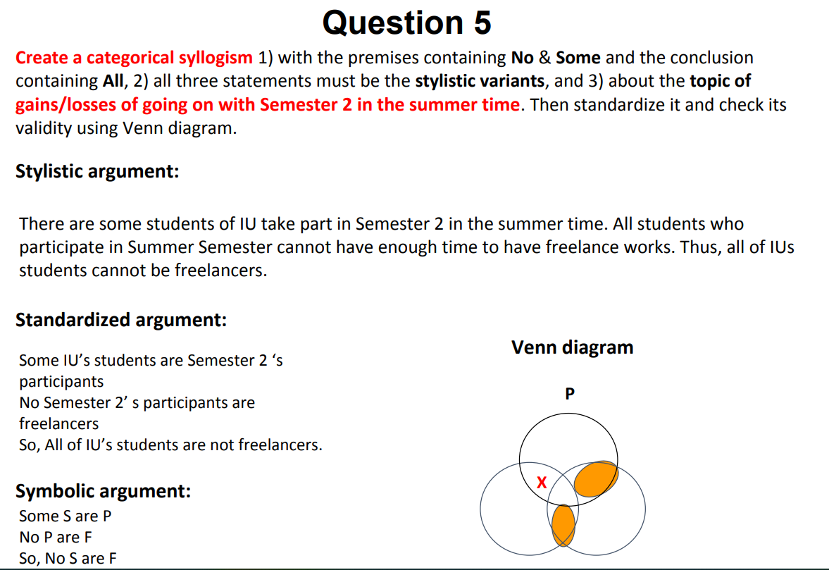
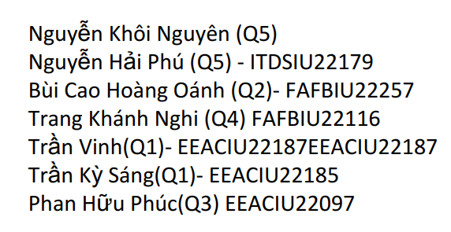

Slide 10
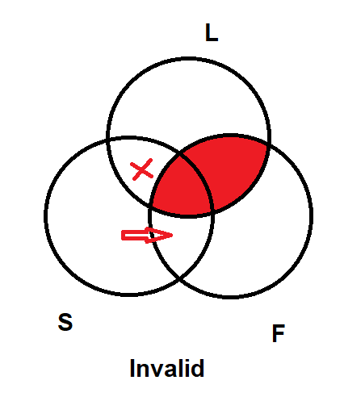
Question 5 – modified
Stylistic argument:
There are some IU students who take Semester 3 in summer.
All students who participate in the summer semester cannot have time for freelance work.
Thus, all of IU students cannot be freelancers.
Standardized argument: Some IU students(S) are not summertime learners. (L)
No summertime learners (L) are freelancers. (F)
So, no IU students are freelancers.
Symbolic argument:
Some S are L
No L are F
So, no S are F

Slide 11
Propositional Logic
Chapter 10
A simple language useful for showing key ideas and definitions
Notes:
In Chapter 9, we learn Venn diagram as a tool to test the validity of categorical logic. Categorical logic is a great way to analyze arguments, but only certain kinds of arguments with two premises from four kinds of categorical statements. This means that categorical logic excludes certain common arguments that are not well-formed arguments in categorical patterns.
For example: I will either go out for dinner tonight or go out for breakfast tomorrow.
I won’t go out for dinner tonight.
So I will go out for breakfast tomorrow.
For this argument, Venn diagram fails to test its validity.
In Chapter 10, we learn one more tool to test the validity of these arguments, which is propositional logic. Remember that both categorical arguments and propositional arguments are deductive reasoning.
Propositional logic, also known as sentential logic and statement logic, is the branch of logic that studies ways of joining and/or modifying entire propositions, statements or sentences to form more complicated propositions, statements or sentences. In our lesson, we’ll learn how to use a tool which is called the Truth table to test the validity of our arguments made up of some propositions.

Slide 12
Review: Proposition
The term proposition is sometimes used synonymously with statement:
- As a simple unit, it expresses a complete idea which can be evaluated as true or false.
Example: HCM International University is a public university.
- As a more complex unit, it combines several statements which can be evaluated as true or false.
Example: HCM International University is a public university and RMIT is a public university.
Notes:
The fundamental logical unit in propositional logic is a statement, or proposition. Simple propositions are statements that contain no other statement as a part. Complex propositions contain more than one simple statement.

Slide 13
Contents
Four types of propositions
1. Conjunction
2. Negation
3. Disjunction
4. Conditional statements
Notes:
In your textbook, there are four types in propositions:
Conjunctions: They are “and” sentences. They put two statements, called conjuncts, together. In Vietnamese, “conjunction” means “phép hội”
Ex: Class learning is interactive and online learning is convenient.
In logic, conjunctions include “but”.
2. Negations: They are “not” statements. They assert that something is not the case. In Vietnamese, “negation” means “phép phủ định”
Ex: Online learning is not convenient.
3. Disjunctions: They are “or” statements. They claim one choice or another, or both. In Vietnamese, “disjunction” means “phép tuyển”
Ex: We can learn online now or we can do make-up class learning.
4. Conditional statements: The conditional is a common type of sentence. It claims that something is true, if something else is also true. In Vietnamese, “conditional statement” means “phép kéo theo”
Ex: If we learn online now, we will not have make-up classes later.

Slide 14
Symbolic connectives
→
Statements are combined by connectives:
&/∧ and Conjunction
˜/¬ not Negation
∨ or Disjunction
→ if Implication/conditional
Notes:
There are universal symbols to indicate the four propositions. We’ll use the four following symbols to suit your textbook:
&: and (conjunction)
˜ : not (negation)
∨: or (disjunction)
→: if (conditional)

Slide 15
Variables and examples of PL statements
Variables: Propositional symbols assigned to different parts of the argument.
P & Q P & ~Q Q → P P v Q (P& Q) → R
It is hot and it is humid. It is hot but it’s not humid. If it is humid, then it is hot. It is hot or it is humid. If it is hot and humid, then it is raining.
Example:
P: It is hot.
Q: It is humid.
R: It is raining.
Notes:
Propositional logic is language, so it has a syntax. The syntax of this language includes the basic symbols plus rules for putting together proper statements.
We use letters to represent simple statements, and these letters are called variables. The term ‘variable’ means that you can change these representative letters the way you want: A, B, C… or P, Q, R… or X, Y Z….
Later on, we will use a letter from the proposition so that you can figure out what it represents more easily.
For example: ‘It is hot.’
You can label this proposition with a variable A or P, or more suggestively, H (meaning ‘hot’).

Slide 16
1. CONJUNCTION (&/and)
A statement can be regarded as true or false (truth values).
A simple statement: a simple sentence regarded as true or false.
Example: IU is a university.
A compound statement: two or more statements regarded as true or false.
Example: Summer is hot and winter is cold.
It is hot and humid.

Slide 17
1. CONJUNCTION – Truth table
Summer is hot and winter is cold.
p q
p q p&q
T T T
T F F
F T F F F F
Note: ‘and’ can be replaced with but, yet, while, whereas, although, though, however
Notes:
Let’s first consider the compound proposition: Summer is hot and winter is cold.
There are two variables in this proposition: p (representing ‘summer is hot’) and q (representing ‘winter is cold’).
There are 4 combinations of these two variables:
p is true (T) and q is true (T)
p is true (T) and q is true (F)
p is true (F) and q is true (T)
p is false (F) and q is false (F)
Column p & q follow the rules:
- A conjunction is true only when all of its variables are true. Or: p & q are true only when p is true and q is true. (case 1)
- A conjunction is false when at least one variable is false, or all variables are false: either p or q is false or both of them are false. (cases 2, 3, 4)
In propositional logic ‘and’ can be replaced with but, yet, while, whereas, although, though, however…. This means the statements which support or contrast each other are also conjuncts.

Slide 18
Truth table for two variables
Truth table for three variables
p | q
T | T
T | F
F | T
F | F
A | B | C
T | T | T
T | T | F
T | F | T
T | F | F
F | T | T
F | T | F
F | F | T
F | F | F
Notes:
There is a trick for you to remember easily: With two variables, we set up a truth table (4 lines) like this:
- Column 1 includes two blocks of two true values and two false values
T
T
F
F
Column 2 (to the right), we alternate the values by a half:
T
F
T
F
When there are three variables set the default columns (8 lines) like this:
- Column 1 includes two blocks of four true values and four false values
T
T
T
T
F
F
F
F
Column 2 (to the right), we alternate the values by a half:
T
T
F
F
T
T
F
F
Column 3 (to the right), we continue to alternate the values by a half:
T
F
T
F
T
F
T
F

Slide 19
EXERCISE
Without knowing what they represent, assume that:
- p, q, r are true
- w, x, y are false
Determine whether each of the following is true or false.
1. p & q 2. p & w
3. x & y 4. r & q
5. r & y 6. y & w
7. x & w 8. q & r
9. p & y 10. r & p
Notes:
Answers:
T
F
F
T
F
F
F
T
F
T

Slide 20
1. Conjunction and validity
Rule of validity:
- In a valid argument, it is impossible for all the premises to be true and the conclusion false.
- If any instance of all true premises is followed by a false conclusion - an F under the conclusion column - the argument is invalid.
p q p&q
T T T
T F F
F T F F F F
Notes:
Do not forget that we can only test the validity of an argument, not a proposition.
The truth table above is set for a proposition, so we can only list all the truth values of the two variables and their conjunctions.

Slide 21
1. CONJUNCTION – Validity
The sky is blue. (p)
The grass is green. (q)
Therefore, the sky is blue and the grass is green.
p q p&q
T T T
T F F
F T F F F F
Notes:
This is an argument (with a conclusion), so now we can test its validity.
Go to the next slide to see how we do it.

Slide 22
1. CONJUNCTION – Validity
The sky is blue (p).
The grass is green (q).
Therefore, the sky is blue and the grass is green.
p* q* p&q C
T T T
T F F
F T F F F F
* The argument is valid.
Symbolic argument:
p
q____
So, p & q
Notes:
In this truth table, we do this:
Put an asterisk (*) next to a variable to mark it as a premise.
Put C next to a conclusion to make it recognizable.
3. We only consider the cases when all the premises are true. In the above example, we only consider line 1 (with all true values of all premises) and ignore lines 2,3,4 (with false values of either premise)
To test validity, we check each line of the truth table to see:
If all the premises in this line are true and the conclusion is true, this line is temporarily valid, then we move on to another line containing all the truth values of the premises.
If we move to the last line and see all the conclusion values are true, this argument is VALID.
If we have any line (top down) with all true premise values and one false conclusion value, we stop and conclude that this argument is INVALID.
In the above argument, there is only one case to consider in line 1: both premises are true. Then we check the conclusion: it is also true. So we stop and conclude: this argument is VALID.

Slide 23
1. CONJUNCTION – Validity
The grass is green (p).
Therefore, the grass is green (p) and the sky is blue (q).
p* q p&q C
T T T
T F F
F T F F F F
Symbolic argument:
p
p & q
* The argument is invalid.
Notes:
Now we have another argument and we set up a truth table for it.
There is one premise with one variable (p).
The conclusion has two variables p & q
There are two cases we need to check: line 1 and line 2, because these two lines contain the true premise.
In line 1, the premise is true and the conclusion is also true: the argument is temporarily valid. Then we move on:
In line 2, the premise is true and the conclusion is false: the argument is false. Then we stop and make the final conclusion.
This argument is INVALID (with at least one false conclusion value)

Slide 24
1. CONJUNCTION – Validity
Tom is short and fat.
Therefore, Tom is short.
pC q p&q*
T T T
T F F
F T F F F F
Symbolic argument:
p & q
p
Notes:
Now we have another argument and we set up a truth table for it.
This argument has two variables: Tom is short (p) and Tom is fat (p).
There is in one premise with a compound proposition: p & q*
The conclusion is variable p^{C}
There is one case we need to check: line 1 which contains the true premise.
We check the conclusion: it its also true.
This argument is VALID.

Slide 25
1. CONJUNCTION – Validity
Tom is short and fat.
Therefore, Tom is short.
p q p&q* pC
T T T T
T F F T
F T F F F F F F
Let’s repeat the p column in the right.
Symbolic argument:
p & q
p
The argument is valid.
Notes:
Now we have another argument and we set up a truth table for it.
This argument has two variables: Tom is short (p) and Tom is fat (p).
There is in one premise with a compound proposition: p & q*
The conclusion is variable p^{C}
There is one case we need to check: line 1 which contains the true premise.
We check the conclusion: it its also true.
This argument is VALID.

Slide 26
Exercise – Testing validity
- p&q
.
. . q

Slide 27
CONJUNCTION – Testing validity
- p&q
.
. . q
p q p&q* qC
T T T T
T F F F
F T F T F F F F
The argument is valid.

Slide 28
2. NEGATION
The use of not to deny a proposition.
Example:
- Tina is tall. (p)
- Tina is not tall. ( ˜p)

Slide 29
2. NEGATION
p q ˜p ˜q
T T F F
T F F T
F T T F
F F T T

Slide 30
NEGATION: Testing validity
Tina is not tall, but Sarah is tall. So, Tina is not tall.
Symbolic argument:
˜p & q
˜p
p q ˜p ˜p&q* ˜p C
T T F F F
T F F F F
F T T T T
F F T F T
The argument is valid.

Slide 31
2. NEGATION: Testing validity (2)
Frank does not drive a truck.
So, Frank does not drive a truck, and Vinny does not drive a van.
Symbolic argument:
˜p
.
˜p & ˜q
p q ˜p* ˜q ˜p& ˜qC
T T F F F
T F F T F
F T T F F
F F T T T
Invalid

Slide 32
3. DISJUNCTION
Two or more statements set apart, usually by the word or.
Example:
- Frank is angry or Hank is tired. (p v q) - For propositional logic, or has non-exclusive sense. This means the statement is true if either Frank is angry or Hank is tired.
p q p v q
T T T
T F T
F T T F F F

Slide 33
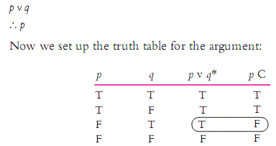
3. DISJUNCTION – truth table
Frank is angry or Hank is tired.
So, Frank is angry.
Symbolic form and the truth table:

Slide 34
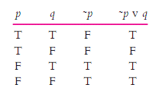
DISJUNCTION and NEGATION – truth table
Frank is not angry or Hank is tired.

Slide 35
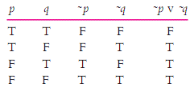
DISJUNCTION and NEGATION – truth table
Frank is not angry or Hank is not tired.

Slide 36
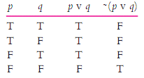
DISJUNCTION and NEGATION – truth table
It’s not the case that Frank is angry or Hank is tired.

Slide 37

CONJUNCTION, NEGATION & DISJUNCTION
It’s not the case that Frank is angry or Hank is tired.
So, Frank is not angry and Hank is not tired.
Symbolic argument:
Let’s set up the truth table:

Slide 38
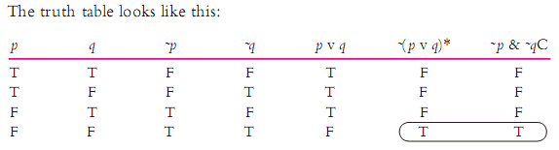
CONJUNCTION, NEGATION & DISJUNCTION
It’s not the case that Frank is angry or Hank is tired.
So, Frank is not angry and Hank is not tired.
Symbolic argument form:

Slide 39

CONJUNCTION, NEGATION & DISJUNCTION
Consider an argument with three variables that involves disjunction, negation, and conjunction:
Frank is angry or Hank is tired.
It’s not the case that Hank is tired and Larry is lonely.
So, Hank is tired.
Symbolic argument:

Slide 40

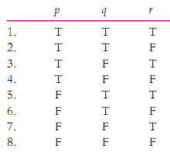
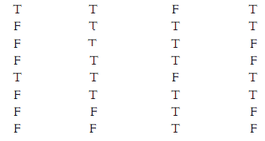
CONJUNCTION, NEGATION & DISJUNCTION
Frank is angry or Hank is tired.
It’s not the case that Hank is tired and Larry is lonely.
So, Hank is tired.
Invalid

Slide 41
4. CONDITIONAL STATEMENTS
If-then statements consisting of 2 parts: antecedent and consequent.
Example:
If it rained, then the ground is wet. (p → q) p q p → q
T T T
T F F
F T T F F T

Slide 42

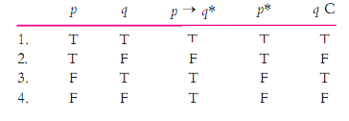
4. CONDITIONAL STATEMENTS
If it rained, then the ground is wet.
It rained.
So, the ground is wet.
Symbolic argument:
Truth table:
Valid

Slide 43
Summary of conjunction (p & q), negation ~(p&q), disjunction (p v q) and conditional statement (p→q)
p | q | ~p | ~q | p & q | ~(p&q) | p v q | p→ q
T | T | F | F | T | F | T | T
T | F | F | T | F | T | T | F
F | T | T | F | F | T | T | T
F | F | T | T | F | T | F | T
Notes:
Tricks to remember values of all propositions:
Conjunction: ONLY two T values: True
Negation: ~(compound proposition)
Disjunction: ONLY one T value: True
Conditional statement:
- same values for antecedent and consequent: True
- different values for antecedent and consequent: get the value of the consequent

Slide 44
Review
1. Propositions/arguments with 2 variables: a true table of 4 lines
2. Propositions/arguments with 3 variables: a true table of 8 lines
3. For propositions, only set up the truth table.
4. For arguments, check validity:
ONLY check the critical rows where all premise values are true, then look for the conclusion values
If all conclusion values are true: valid
If at least one conclusion value is false: invalid
*Note: Check the critical rows top down: True -> go on; False -> stop

Slide 45
PRACTICE
Convert each statement into symbolic form and generate its truth table.

Slide 46
1. The weather is beautiful outside but we cannot enjoy it.
Let:
Symbolic form:
W: the weather is beautiful outside
E: we can enjoy it
W & ~E
W | E
T | T
T | F
F | T
F | F

Slide 47
1. The weather is beautiful outside but we cannot enjoy it.
Let:
Symbolic form:
W: the weather is beautiful outside
E: we can enjoy it
W & ~E
W | E | ~E | W & ~E
T | T | F | F
T | F | T | T
F | T | F | F
F | F | T | F

Slide 48
2. If you want a good score but you don’t make efforts, your want is just wishful thinking.
Let:
G: you want a good score
E: you make efforts
W: your want is just wishful thinking
Symbolic form:
G & ˜E → W
G | E | W
T | T | T
T | T | F
T | F | T
T | F | F
F | T | T
F | T | F
F | F | T
F | F | F

Slide 49
2. If you want a good score but you don’t make efforts, your want is just wishful thinking.
Let:
G: you want a good score
E: you make efforts
W: your want is just wishful thinking
Symbolic form:
G & ˜E → W
G | E | W | ˜E | G & ˜E | G & ˜E → W
T | T | T | F | F | T
T | T | F | F | F | T
T | F | T | T | T | T
T | F | F | T | T | F
F | T | T | F | F | T
F | T | F | F | F | T
F | F | T | T | F | T
F | F | F | T | F | T

Slide 50
3. If we don’t revise the lesson contents, we will fail the midterm exam and our course scores will be low.
Let:
R: we revise the lesson contents
F: we will fail the midterm exam
S: our course scores will be low
Symbolic form:
˜R → F & S
R | F | S
T | T | T
T | T | F
T | F | T
T | F | F
F | T | T
F | T | F
F | F | T
F | F | F

Slide 51
3. If we don’t revise the lesson contents, we will fail the midterm exam and our course scores will be low.
Let:
R: we revise the lesson contents
F: we will fail the midterm exam
S: our course scores will be low
Symbolic form:
˜R → F & S
R | F | S | ˜R | F & S | ˜R → F & S
T | T | T | F | T | T
T | T | F | F | F | T
T | F | T | F | F | T
T | F | F | F | F | T
F | T | T | T | T | T
F | T | F | T | F | F
F | F | T | T | F | F
F | F | F | T | F | F

Slide 52
Exercise 4: Test validity of the argument

Slide 53
4A. If the pandemic doesn’t end or we will study online again next semester, life is not fun for us at all. The pandemic does not end yet but we will not study online again next semester. So, life is fun for us.
Let:
E: the pandemic ends
S: we study online again next semester
F: life is fun for us
Symbolic argument:
˜E v S → ˜F
˜E & ˜S
∴ F
E | S | F
T | T | T
T | T | F
T | F | T
T | F | F
F | T | T
F | T | F
F | F | T
F | F | F
In/valid

Slide 54
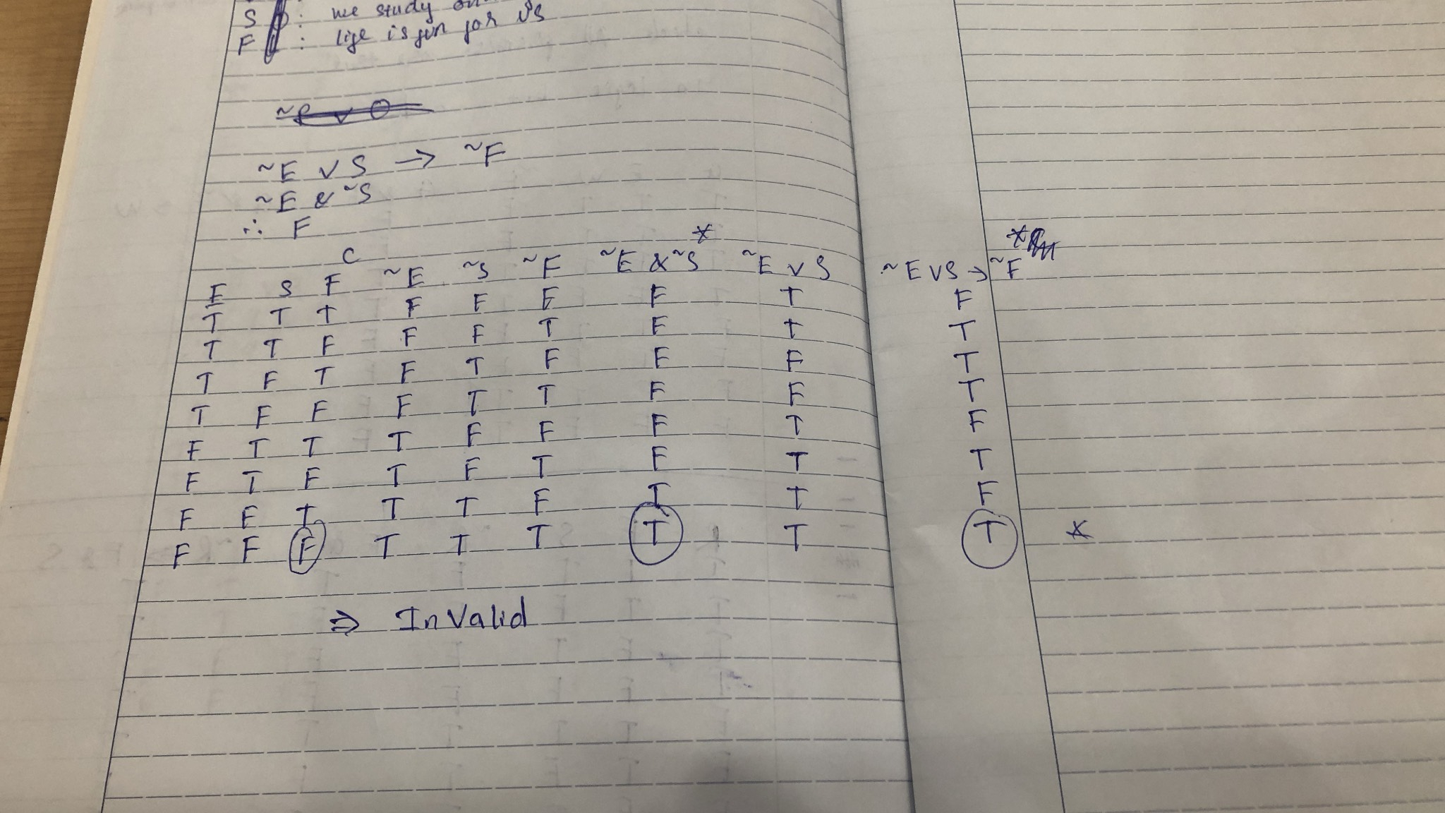
Notes:
NhuY

Slide 55
4A. If the pandemic doesn’t end or we will study online again next semester, life is not fun for us at all. The pandemic does not end yet but we will not study online again next semester. So, life is fun for us.
Let:
E: the pandemic ends
S: we study online next semester
F: life is fun for us
Symbolic argument:
˜E v S → ˜F
˜E & ˜S
∴F
E | S | F | ˜E | ˜S | ˜F | ˜EvS | ˜EvS →˜F* | ˜E&˜S* | F^{C}
T | T | T | F | F | F | T | F | F | T
T | T | F | F | F | T | T | T | F | F
T | F | T | F | T | F | F | T | F | T
T | F | F | F | T | T | F | T | F | F
F | T | T | T | F | F | T | F | F | T
F | T | F | T | F | T | T | T | F | F
F | F | T | T | T | F | T | F | T | T
F | F | F | T | T | T | T | T | T | F
Invalid

Slide 56
4B. If our teacher checks attendance, absentees will be recorded and they will be prohibited from the exam. Our teacher doesn’t check attendance, so absentees will still take the exam.
T = teacher checks attendance
R = absentees will be recorded
P = absentees will be prohibited
Symbolic argument:
T → R & P
~T
∴ ~P
T | R | P
T | T | T
T | T | F
T | F | T
T | F | F
F | T | T
F | T | F
F | F | T
F | F | F
In/valid

Slide 57
4B. If our teacher checks attendance, absentees will be recorded and they will be prohibited from the exam. Our teacher doesn’t check attendance, so absentees will still take the exam.
Symbolic argument:
T → R & P
~T
∴~P
T = teacher checks attendance
R = absentees will be recorded
P = absentees will be prohibited
T | R | P | ~T* | ~P^{C} | R & P | T → R & P*
T | T | T | F | F | T | T
T | T | F | F | T | F | F
T | F | T | F | F | F | F
T | F | F | F | T | F | F
F | T | T | T | F | T | T
F | T | F | T | T | F | T
F | F | T | T | F | F | T
F | F | F | T | T | F | T
Invalid

Slide 58
4C. My girlfriend's phone at work is busy. My best friend's phone is also busy. If they are talking to each other, then both phones are busy. So, my girlfriend and my best friend are talking to each other over the phone.
Symbolic argument:
G
B
T → G & B
∴ T
G = My girlfriend’s phone at work is busy
B = My best friend’s phone at work is busy
T = My girlfriend & best friend talk to each other
G * | B* | T
T | T | T
T | T | F
T | F | T
T | F | F
F | T | T
F | T | F
F | F | T
F | F | F
In/valid

Slide 59
4C. My girlfriend's phone at work is busy. My best friend's phone is also busy. If they are talking to each other, then both phones are busy. So, my girlfriend and my best friend are talking to each other over the phone.
Symbolic argument:
G
B
T → G & B
∴ T
G = My girlfriend’s phone at work is busy
B = My best friend’s phone at work is busy
T = My girlfriend & best friend talk to each other
G * | B* | T | G & B | T → G & B* | T C
T | T | T | T | T | T
T | T | F | T | T | F
T | F | T | F | F | T
T | F | F | F | T | F
F | T | T | F | F | T
F | T | F | F | T | F
F | F | T | F | F | T
F | F | F | F | T | F
Invalid

Slide 60
4D. If Group A doesn’t do the assignment, Group B doesn’t do it, either. If these groups don’t do it, other groups will get the bonus points. So, if one of these groups doesn’t do the assignment, other groups will get the bonus points.
Symbolic argument:
~A → ~B
~A & ~B → G
∴ ~A v ~B → G
A = Group A does the assignment
B = Group B does the assignment
G = other groups get the bonus points
Invalid line 4
A | B | G | ~A | ~B | ~A&~B | ~A→~B * | ~A&~B → G * | ~A v ~B | ~A&~B → G C
T | T | T | F | F | F | T | T | F | T
T | T | F | F | F | F | T | F | F | F
T | F | T | F | T | F | T | T | T | T
T | F | F | F | T | F | T | T | T | F
F | T | T | T | F | F | F | T | T | T
F | T | F | T | F | F | F | T | T | F
F | F | T | T | T | T | T | T | T | T
F | F | F | T | T | T | T | F | T | F
Invalid

Slide 61
4D. If Group A doesn’t do the assignment, Group B doesn’t do it, either. If these groups don’t do it, other groups will get the bonus points. So, if one of these groups doesn’t do the assignment, other groups will get the bonus points.
Symbolic argument:
~A → ~B
~A & ~B → G
∴ ~A v ~B → G
A = Group A does the assignment
B = Group B does the assignment
G = other groups get the bonus points
A | B | G | ~A | ~B | ~A → ~B* | ~A & ~B | ~ A & ~ B → G* | ~ A v ~ B | ~ A v ~ B → G^{C}
T | T | T | F | F | T | F | T | F | T
T | T | F | F | F | T | F | F | F | T
T | F | T | F | T | T | F | T | T | T
T | F | F | F | T | T | F | T | T | F
F | T | T | T | F | F | F | T | T | T
F | T | F | T | F | F | F | T | T | F
F | F | T | T | T | T | T | T | T | T
F | F | F | T | F | F | F | T | T | T
Invalid

Slide 62
ASSIGNMENT
Instructions:
The question “Who’s the thief?” is optional. Your weekly assignment includes 5 tasks that follow.
Delete all the lesson slides and keep only the Assignment slides to resubmit.
Link to submit:
https://forms.gle/BfU76DhUBc3ztGpm9

Slide 63
Names of your group

Slide 64
Who’s the thief?
OPTIONAL QUESTION
A theft was committed by one of the 9 people (called One to Nine) but the police don’t know who did it. Here are their answers when questioned:
One: Five is the thief.
Two: No, it’s not true!
Three: I did it.
Four: Either Three or Eight is the thief.
Five: Two said the wrong thing!
Six: Three is the thief.
Seven: No, Three is not the thief.
Eight: I’m not the thief, and Three is not, either.
Nine: What Eight says is correct, but Five is not the thief, either.
If only 3 out of 9 statements are true, who could be the thief?

Slide 65

Task 1: Don’t take the elevator (E) to the second floor or push your friends (P). It’s not the case that we ride the elevator that way but we don’t annoy our friends (A). If we push, we surely annoy them, too.
Let:
Symbolic argument:
Truth table
Add/Delete columns to suit your argument.
Invalid

Slide 66
Task 2: If a students doesn’t do two quizzes before the midterm exam, his/her quiz average will be halved. Some students do either Quiz 1 or Quiz 2. So their quiz average will not be halved if they do both quizzes.
Let:
Symbolic argument:
Truth table
Add/Delete columns to suit your argument.
Conclusion:

Slide 67
Task 3: If we do group assignments carefully or we do textbook exercises, we’ll be well prepared for the mid-term exam. It’s not the case that we do group assignments carefully but we don’t do all textbook exercises. So, we’ll get ready for the mid-term exam if we do them both.
Let
Symbolic argument
Truth table
Add/Delete columns to suit your argument.
Conclusion

Slide 68
Task 4: Create a propositional argument about the topic of one good/bad thing in your student life with three variables, including at least a disjunction, a negation of a conjunction and a conditional statement, then turn it into the symbolic argument and evaluate its validity.
Your argument
Truth table
Symbolic argument
Add/Delete columns to suit your argument.
Conclusion

Slide 69
Task 5: Create a propositional argument about the topic of your interest/nightmare with three variables including at least a conjunction, disjunction, a negation, and a conditional statement, then turn it into the symbolic argument and evaluate its validity using the truth table.
Your argument
Truth table
Let
Add/Delete columns to suit your argument.
Symbolic argument
Conclusion:

Slide 70
Attendance check – Week 6
Makeup class for Thursday - May 25
Online class
Monday morning: May 22

Slide 71
Thank you ☺

